Slide 1
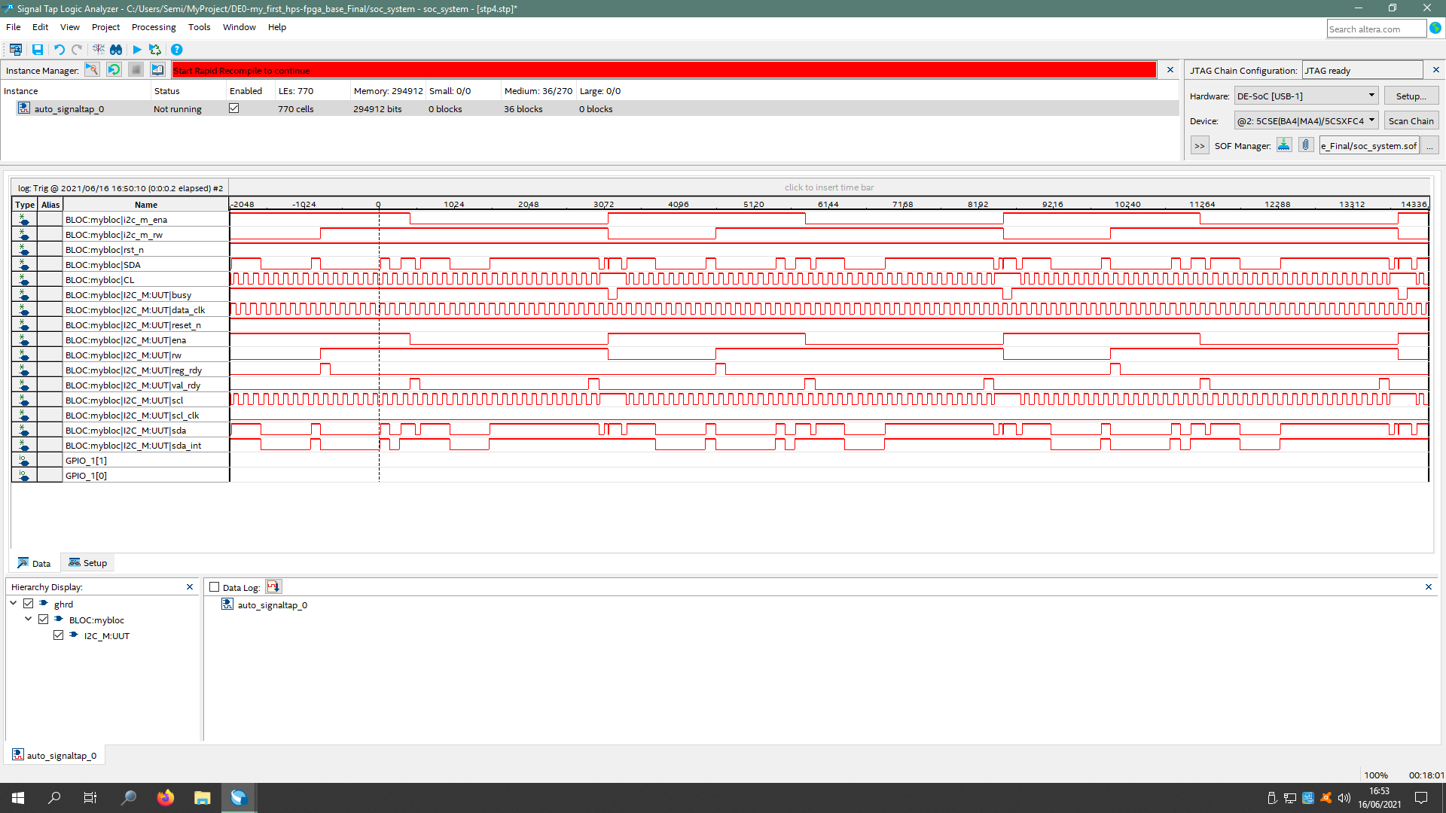

Slide 2
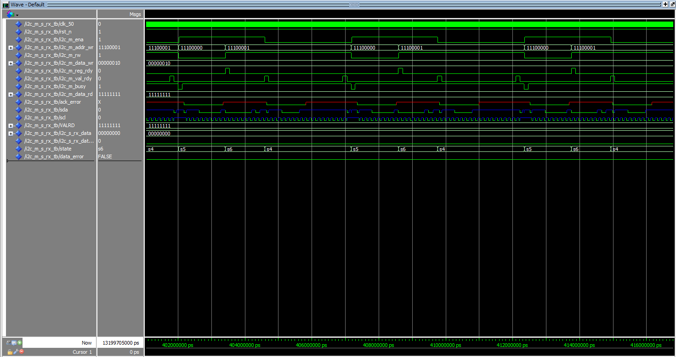

Slide 3
Comparisons of the first two slides
Looking at the first two slides, we can observe that we get the same sequence between the simulation and the signal analysis.

Slide 4
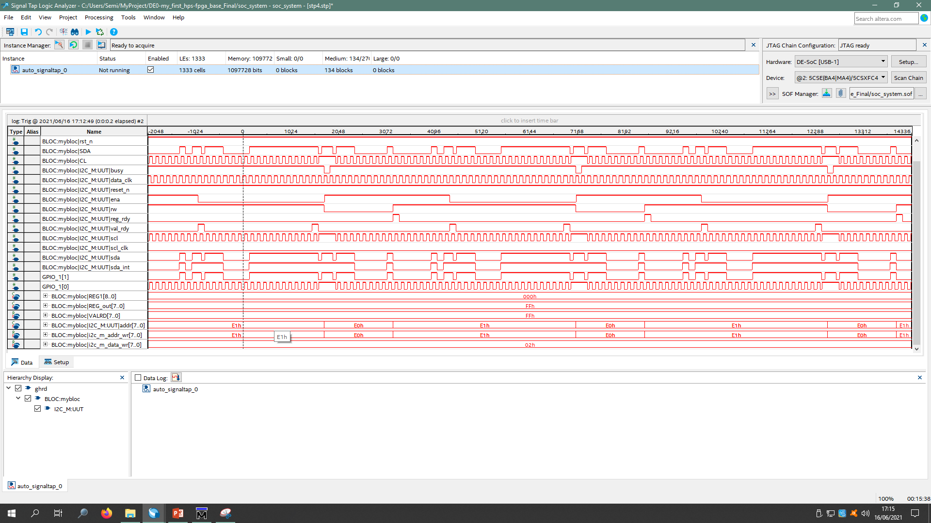

Slide 5
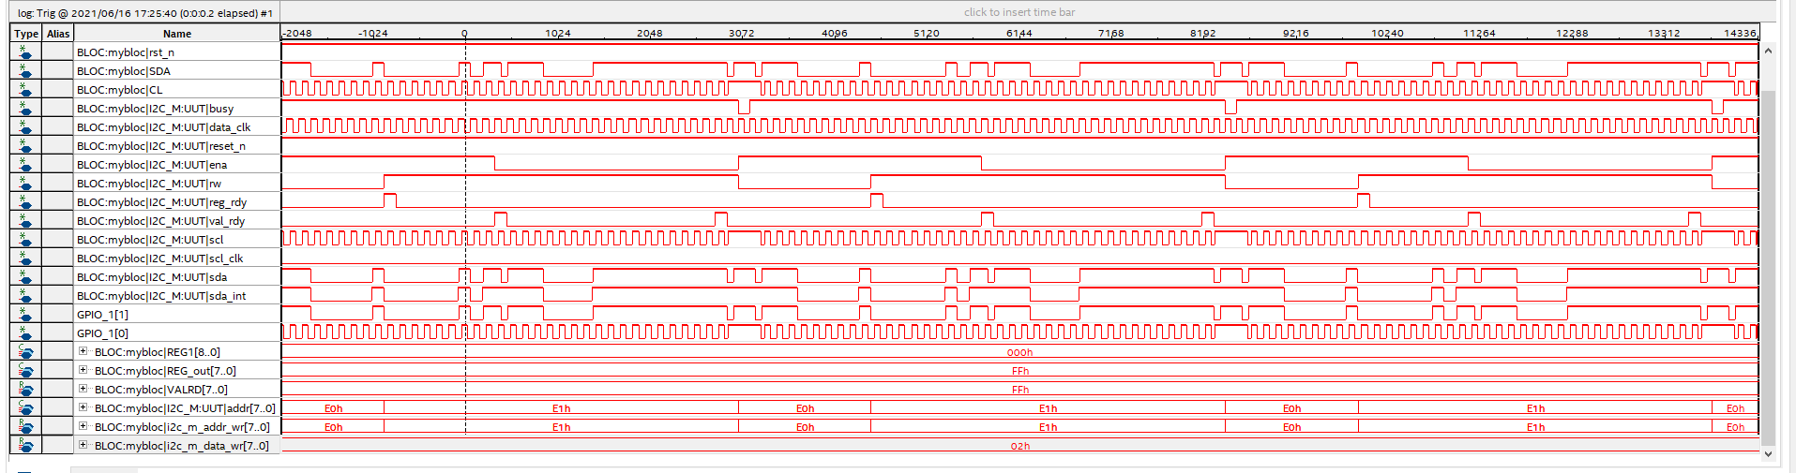

Slide 6
Observation of the last two slides
Looking at the last two slides, we can see that we are reading FF because the sensor is not connected (and 00 when it is connected because we have not set a read delay). We can also see the writing and reading props E0 and E1. Finally, we can see that we are interacting with register 02.

